Slide 1

INDUSTRY COMPETITIVENSS ANALYSIS
AUTOMOBILE INDUSTRY

Slide 2

Prepared in fulfilment by
At
BITS Pilani Hyderabad Campus
Under Supervision of Dr. Niranjan Swain
Course Title: Business Analysis and Valuation
Birla Institute of Technology and Sciences, Pilani – Hyderabad 18th September, 2022

Slide 3
ACKNOWLEDGEMENT
We express our sincere gratitude to Dr. Niranjan Swain, Professor, Department of Economics & Finance and Dean of Administration section, BITS Pilani Hyderabad Campus for allowing us to work under him for this assignment and for taking his valuable time to provide us with the necessary guidance wherever required.
His input proved to be very vital for the assignment. We want to thank him for giving us an excellent opportunity to apply our course knowledge to real-life data and get hands-on experience. We are indebted for all his help and guidance throughout the course and this assignment.
18th September, 2022 Hyderabad

Slide 4
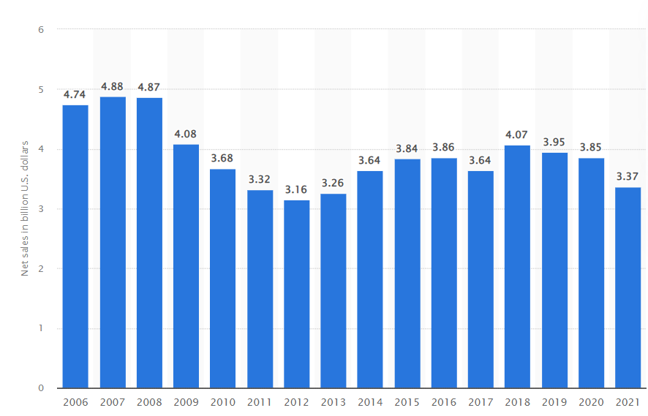

Introduction
Yamaha Motor Co.
Yamaha Motor Co., Ltd. is a global Japanese company that produces motorbikes, maritime items, and other motorized goods. After splitting from Yamaha Corporation, the firm was founded in 1955. It has its headquarters in Iwata, Shizuoka, Japan. Its revenue for the quarter ending June 30, 2022, was $1M, and for the twelve months ending June 30, 2022, it was $11.960B, a 17.13% decline from 2021.
.

Slide 5
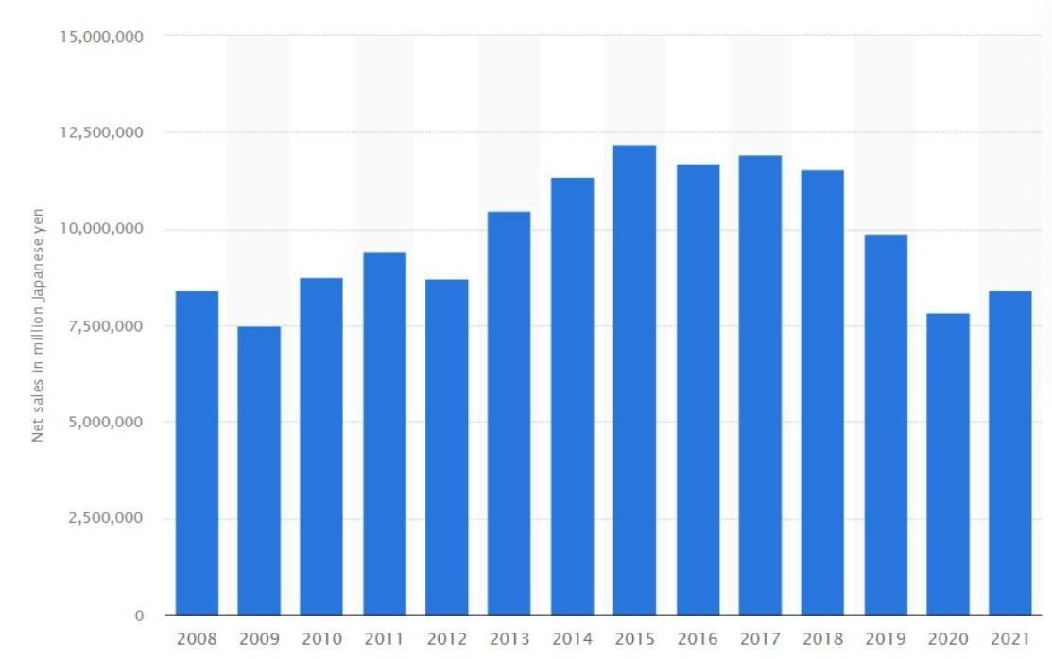

Nissan Motor Co.
INTRODUCTION
Nissan Motor Co., Ltd. is a global Japanese automaker with its main offices in Nishi-Ku, Yokohama, Japan. The firm offers its cars under the Nissan, Infiniti, and Datsun names, along with its line of Nismo performance modification goods. Nissan Motor's revenue for the three and twelve months ended June 30, 2022, respectively, was $16.457B and
$73.161B, a 9.97% year-over-year fall. Its yearly sales in 2022 increased by 1.45% from 2021 to $74.979 billion

Slide 6
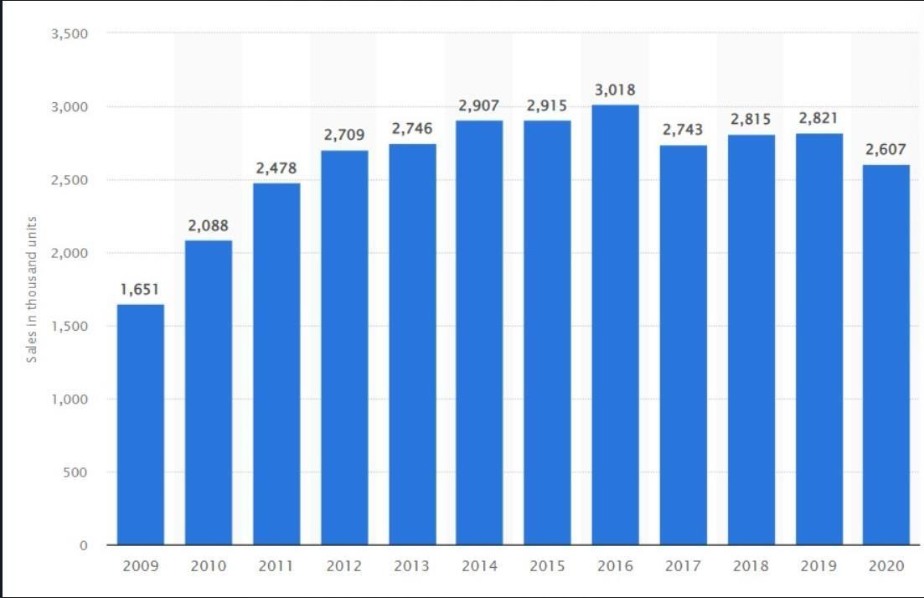

KIA Corporation
INTRODUCTION
Kia Corporation, sometimes known simply as Kia, is a global South Korean automaker with its headquarters in Seoul. It is the second-largest automaker in South Korea, selling more than 2.8 million vehicles in 2019. Currently, Kia produces 1.4 million automobiles annually. It has 14 production facilities, and assembly work is done in eight nations. A global network of 3,000 distributors and dealers serving 172 nations sells and maintains automobiles. The company has more than 40,000 workers and generates more than US$17 billion yearly revenue.

Slide 7
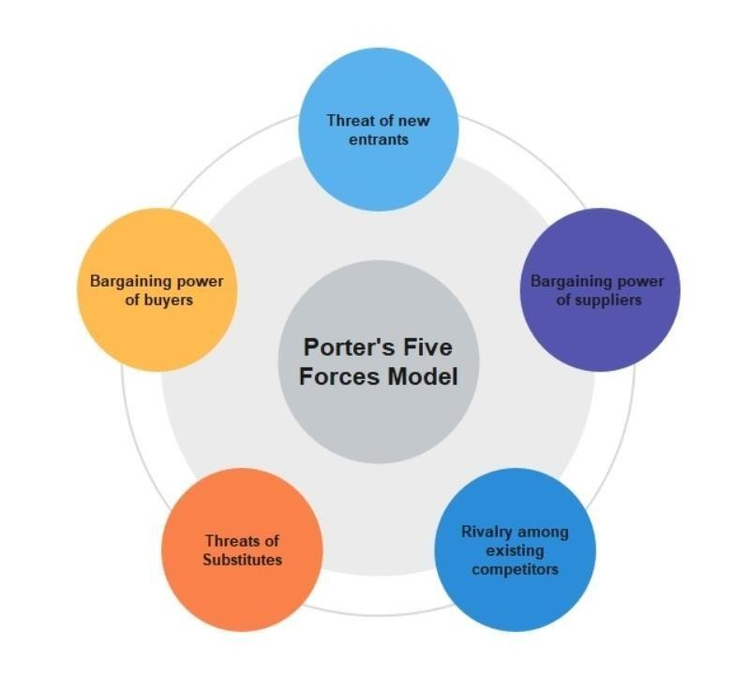
INDUSTRY ANALYSIS
PORTER’S 5 FORCES FOR AUTOMOBILE INDUSTRY
Porter's Five Forces is a business analysis framework that aids in illuminating why different sectors are able to maintain varying levels of profitability.
Competitive Strategy: Techniques for Analyzing Industries and Competitors, written by Michael E. Porter, released the concept in 1979. The intensity, attractiveness, and profitability of
rivalry in a market or sector are typically assessed using the Five Forces model.

Slide 8
PORTER’S FIVE FORCES
1.Rivalry between existing firms: High
The competitive environment among existing enterprises in most industries significantly impacts the average profitability level. In some industries, businesses compete fiercely, driving prices to (and occasionally below) the marginal cost. Other than that, firms in specific sectors do not aggressively compete on pricing. They instead discover methods for pricing coordination or rivalry based on non-price factors like innovation, service, or brand perception.
Rivalry among firms in the automobile industry is high for several reasons. This industry is saturated with key and strategic players who enjoy an equally distributed market share. For instance,
Yamaha competes in a crowded market with several established brands, like Royal Enfield, Honda, KTM, Bajaj, Suzuki, Hero, and many more. Most of these rivals have a strong track record and provide goods in markets where even Yamaha does not compete.
One of the automakers facing intense competition on a global scale is Nissan. Local and international rivals include Toyota, Honda, GM, and Daimler Chrysler.
There are not many rivals in that frame of mind in which Kia works, yet the more significant part has a massive measure of a piece of the pie.
There is high item separation which helps in diminishing the opposition. However, the exchange costs are low. This intends that there will be less battle for a piece of the pie, yet everybody will attempt to catch the new clients. This multitude of variables shows that the cutthroat competition is high in the business, and Kia should be ready for any challenge.
After all this, the companies are the most lucrative vehicle companies globally. The companies differentiate themselves based on their brand positioning and brand values. A differentiating feature is the business's attempt to increase its market share through strategic alliances that benefit the company or devoted consumers. Companies should use unconventional marketing techniques to stand apart since new inventions will be simple to replicate and modify.
Considering all the elements mentioned above, we can say that competitive rivalry is a strong force affecting the operations of the automobile industry.

Slide 9
PORTER’S FIVE FORCES
2.Threat of entry of new firms: Weak
The threat of new entrants, one of the 5 Porter's forces, plays a crucial role in determining the attractiveness of a sector. It also significantly affects a firm's ability to make abnormal profits in an industry. Some key factors which dictate terms of entry are
Economies of scale
Barriers to entry
Legal Barriers(Government regulations)
It is appropriate for existing enterprises inside an industry with significant entry barriers since the company would be able to charge higher rates and negotiate better conditions.
In the case of Yamaha this approach, the motorcycle sector has very high entry barriers, making it challenging for new brands to enter. Therefore, any threat from a new brand is still minimal. By doing this, the overall threat posed by a new brand is kept low.
One of the top automakers around the globe is Nissan. Since its product portfolio has established high standards and makes, it is tough for new entrants to compete. The automobile industry also requires a sizable sum of money for startup costs, and economies of scale are challenging to
build a customer base since customer switching costs are high.
In the sector where Kia Motors competes, achieving economies of scale is challenging. It also raises the cost of production for new competitors. As a result, the dangers posed by new competitors are less potent. Since the industry has high capital needs, it is challenging for new entrants to launch enterprises because significant expenses must be invested. Due to all of these elements, the threat of new competitors is less potent in this
market.
It is difficult for new brands to enter the automobile industry because of the significant investment required for establishing the brand. Unless a new brand brings an innovative and differentiated product to the market, the chances of gaining a significant market share are low. Gaining access to the distribution channel is difficult, which increases the threat of new entrants. The capital required to enter the business is also high, adding to the threat of new entrants.

Slide 10
PORTER’S FIVE FORCES
3 . Threat of Substitute Products: Low
Companies fear that substitute products or services could displace their own. Relevant substitute products need not be of the same form but could be of the same function as well. When competitors or businesses outside the industry provide more alluring and/or less expensive items, there is a greater risk of substitution. Then, buyers can choose to trade off performance for the price. Another factor is the cost of switching. If it is high, there is less risk of substitution. Along with the above factors, the willingness of customers to substitute also matters.
Yamaha has already released fuel-efficient bikes. The design, innovation, and efficiency of Yamaha motorcycles reduce the total threat posed by substitutes. There are loyal customers who realize the brand equity of Yamaha and will always prefer to be associated with it, which reduces the threat of substitutes for Yamaha.
Nissan industry producers sell their products at a reduced cost with acceptable quality than substitutes. As a result, consumers are less likely to move to substitute goods. Nissan is also concerned about substitutes from Hyundai, Toyota, and other brands. In order to draw in new customers, Nissan must innovate its vehicles and offer cutting-edge features.
Kia has gained a brand name by delivering efficient cars at a much more affordable price. There is high differentiation in the products, and customers know the benefits of buying from Kia Motors. Other substitutes like two-wheelers and public transport do not count as people who want to buy their conveyance will not consider their products an option.
Today we have several substitutes and alternative modes of transportation, including cab services and public transport. However, none of them can provide the kind of accessibility and convenience that owning an automobile does. Owning a car is both a matter of convenience and prestige for most. Be it a hike in fuel prices or any other reason that increases the overall maintenance of the automobile, and consumers mostly prefer owning one. So the threat of substitute products is low.

Slide 11
PORTER’S FIVE FORCES
4 . Bargaining Power of Buyers: Moderately High
Porter's Five Forces of Customer Bargaining Strength refers to the pressure customers can apply to businesses to persuade them to provide higher-quality goods, better customer service, and lower costs. The theory behind this is that a seller's ability to attain profitability is influenced by the bargaining power of buyers in an industry, which in turn affects the seller's competitive environment. A powerful buyer might increase industry competition and reduce the seller's potential profit. On the other hand, a weak buyer depends on the seller for both quality and price, which reduces industry competition and boosts the seller's potential for profit.
Yamaha is one of the most well-known sports bike brands and has considerable negotiating strength. They can moderate the bargaining power of the purchasers by combining fantastic technology with excellent style. The overall buying power of consumers in the motorcycle sector is reasonably high in the twenty-first century. Brands aim to attract new customers with more advanced technologies and lower prices.
Customers in this industry have more negotiating power since they can access complete product information via online channels and easily compare
products to find the best. This is brought on by the high retail price of the goods. Additionally, customers have limited power because buyers are distributed around the globe, and licensed dealers may only sell new cars. The buyer's negotiation power is constrained when purchasing a specific product. Buyer power is not extreme, but it exists.
The alternatives available to the customer are restricted since the goods or services provided by the various market participants vary at every stage.
Because the customer's income is constrained, there are fewer possibilities for purchases. Because the consumer is making a large purchase, they take their time making a choice and occasionally locate a superior alternative at a lower price. Although all of these indicators point to lower-than-average supplier negotiating power, the business should focus on its consumers. Even with few alternatives, clients may move with little to no effort and are likely not bothered by a little price increase for superior services.
Most of the customers are small individual buyers that buy single vehicles. However, there are corporations and government agencies that buy fleets of vehicles. Such buyers are in a position to bargain for lower prices. Also, such buyers are price primarily sensitive and would switch to another brand that offers a better product at a lower price. However, none of the buyers, whether big corporations or individual small buyers pose a threat of backward integration. Based on the overall view, their bargaining power is moderately high.

Slide 12
PORTER’S FIVE FORCES
5 .Bargaining power of suppliers: Low
The bargaining power of suppliers refers to the pressure that suppliers can exert on businesses by increasing their prices, diminishing their quality, or limiting the availability of their products. It is the polar opposite of the bargaining power of buyers. The buyers' competitive climate and profit potential are impacted by the supplier's negotiating strength in a particular industry. One factor that influences an industry's competitive environment and contributes to its attractiveness is the negotiating power of its suppliers. The other forces include competitiveness in the marketplace, buyer bargaining power, the threat of replacements, and the threat of new competitors.
Aside from Japan, Yamaha has suppliers in various other nations worldwide. It has collaborated with them to manage the supply chain more effectively. Based on a relationship for mutual advantage, this partnership. Yamaha's market dominance and scale give it power. Due to their dispersed location and lesser size across the globe, its suppliers do not have much control. Their ability to negotiate is still restricted, and Yamaha has a wide range of options based on their availability. As a result, Yamaha has enormous supplier leverage. Their overall negotiating leverage is still tiny and weak.
Due to their complex specifications and numerous accessories and parts, automobiles are challenging to construct. High-quality parts are what Nissan wants as part of its quality control, giving its dependable suppliers more negotiation power. When Nissan makes much money, suppliers will boost the price of raw materials to compete for business. If the brand demands prompt delivery, suppliers will increase their prices. Nissan needs to keep good relations with its suppliers and keep looking for new ones to reduce shortages and price hikes. Since the suppliers lack the knowledge and resources necessary to manufacture automobiles, the threat of forwarding integration is minimal in this sector.
The number of suppliers in this industry is vast, and most of them sell the same kind of base product; hence the options available to Kia motors to switch suppliers are suitable. The switching costs are low, and the company cannot afford to get low-quality products. The product offered by suppliers does not have any other alternative use, thus further decreasing their bargaining power. There are minimal chances of forwarding integration by them, and having ties with a vast company like Kia Motors helps them sustain business in this competitive market and maintains an edge over other suppliers. All these factors indicate that the bargaining power of suppliers is weak.
The bargaining power of suppliers in the automotive industry is weak because most are small players. Only a few of them are significant in size. The threat to forwarding integration is minimum.

Slide 13
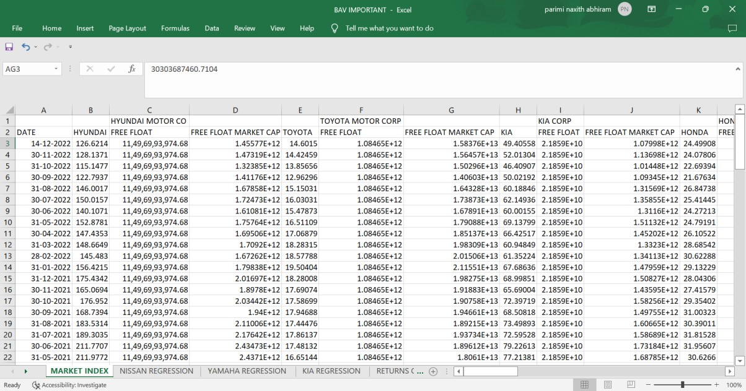
Systematic and Unsystematic Risk Analysis of (Nissan, KIA, Yamaha)
Report: First as directed by Swain sir we have collected data from BMC the top 15 companies of the Automobile industry and we have created a market index with the data of closing price, and free float shares we found the free float market cap and created an index from past years data
Now after creating the Index we have found the returns of shares of the companies from the data and from there we found beta for each company by running a regression in excel.

Slide 14
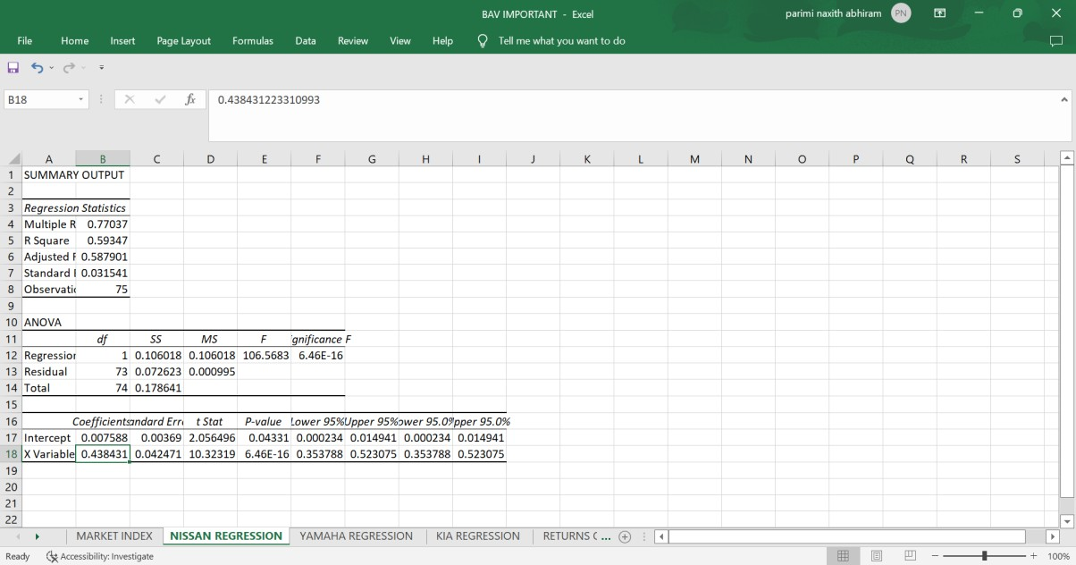
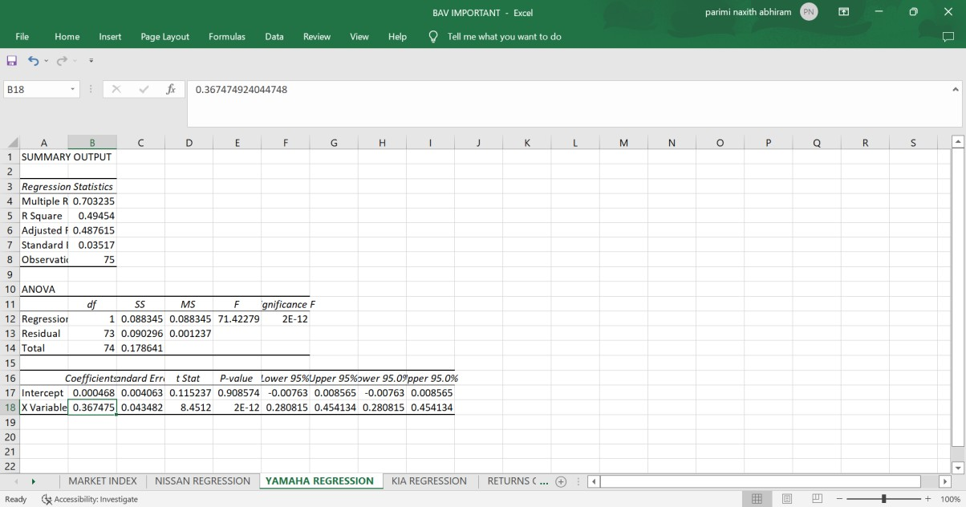

Slide 15
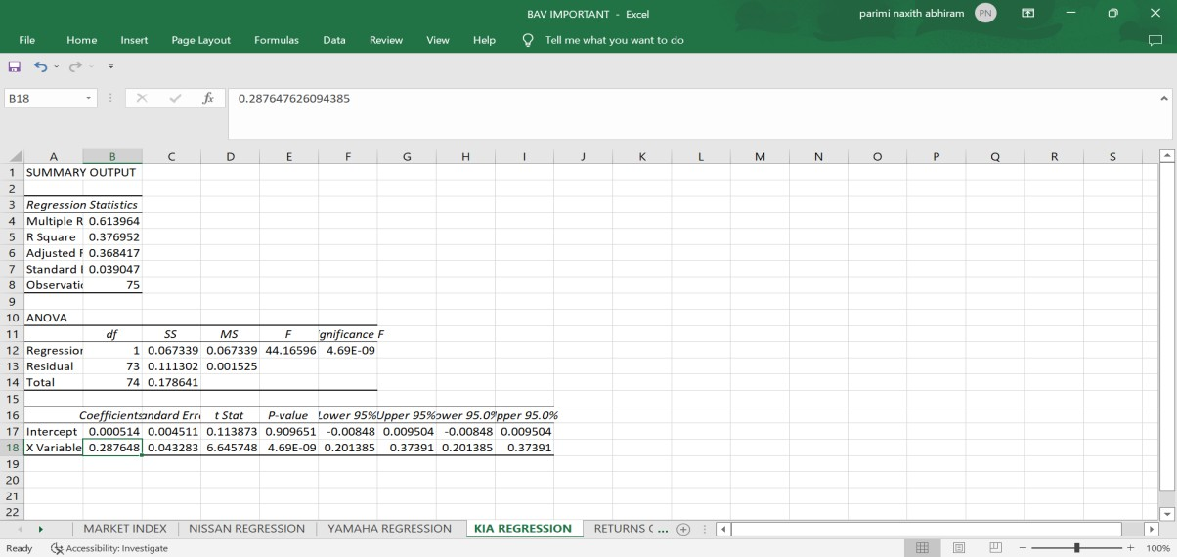
After finding the Beta for the companies we have taken we started to calculate the cost of equity of companies Nissan, KIA, and Yamaha and we followed the process that was instructed to us and found the values of cost equity to be
Cost of equity: Risk-free rate+BETA(MARKET RISK PREMIUM)
Cost of equity of Nissan: 8.82% Cost of equity of KIA: 6.25% Cost of equity of Yamaha: 7.98%

Slide 16

After that, we calculated the cost of debt using the risk-free rate and interest coverage ratio and from there we found the spread
From there with help of the total debt total equity ratio, we found the weight of equity and weight of debt Now from there, we found the WACC (weighted average cost of capital) using the formula below
WACC = Wb*Rb+Ws*Rs
Wb=weight of debt Rb=cost of debt Ws=weight of equity Rs=cost of equity
From here we found the WACC of our three companies which is Nissan, KIA, Yamaha WACC(Nissan) = 6.81%
WACC(KIA) = 5.84%
WACC(YAMAHA)= 6.66%

Slide 17
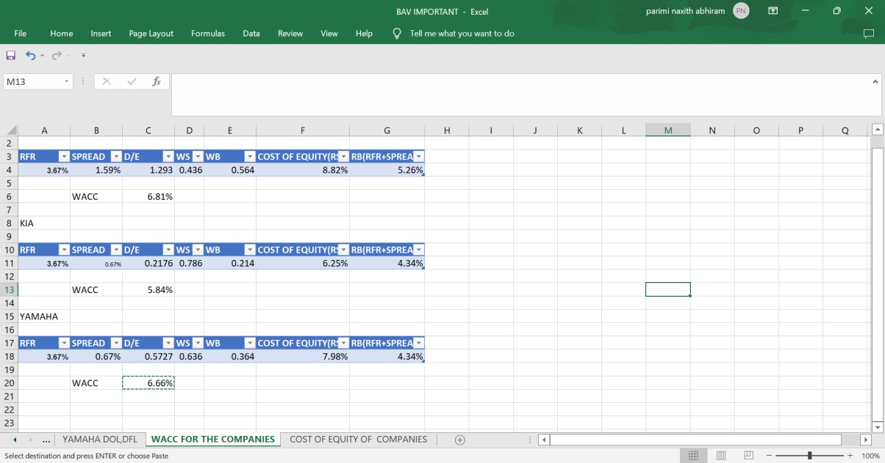
Now after that, we found the DOL, and DFL of the companies we have taken by using the EPS, EBIT, and Net operating income to sales and found the values
NISAAN
DOL : -0.163879594
DFL : -0.853198342
KIA
DOL: 0.0625521
DFL: 4.3100021
YAMAHA

Slide 18
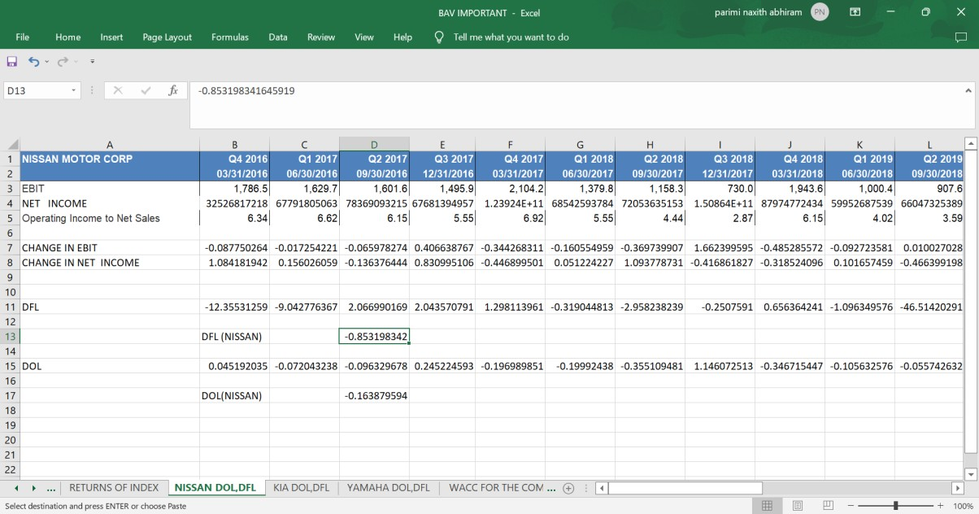
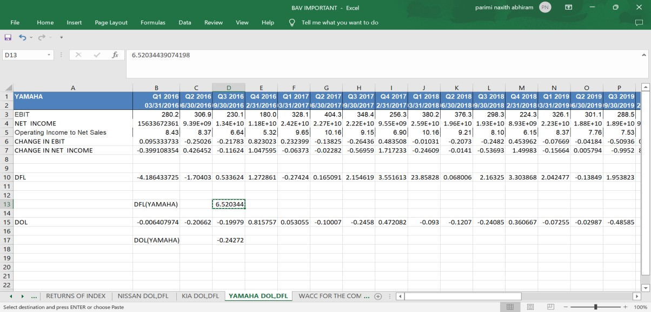
DOL: -0.24272
DFL: 6.520344
RISK ANALYSIS :
SYSTEMATIC
On the basis of Beta value, we can decide how the companies are performing So from calculated values of Beta
NISSAN: 0.438431
It is positively correlated to market return but is moving slowly respective to market
KIA: 0.287648
It is positively correlated to market return but is moving slowly respective to market
YAMAHA: 0.367475
It is positively correlated to market return but is moving slowly respective to market

Slide 19
UNSYSTEMATIC
We have found the DOL, and DFL values of the companies so now we will compare them with Industry averages The industry average is
DFL 0.11
DOL 12.47
So making this a benchmark we can analyze the companies
NISAAN
DOL : -0.163879594
DFL : -0.853198342
So if we see that both DOL AND DFL are lower than that of the market for NISSAN implying they are having less favorable leverage position
KIA
DOL: 0.0625521
DFL: 4.3100021
So if we see this case the degree of operating leverage is not in favor of Kia motors but the degree of financial leverage was in favor of them YAMAHA
DOL: -0.24272
DFL: 6.520344
Similar to the above one Yamaha motors also have an edge in the degree of financial leverage and are in an unfavorable position in case of the degree of financial leverage.

Slide 20
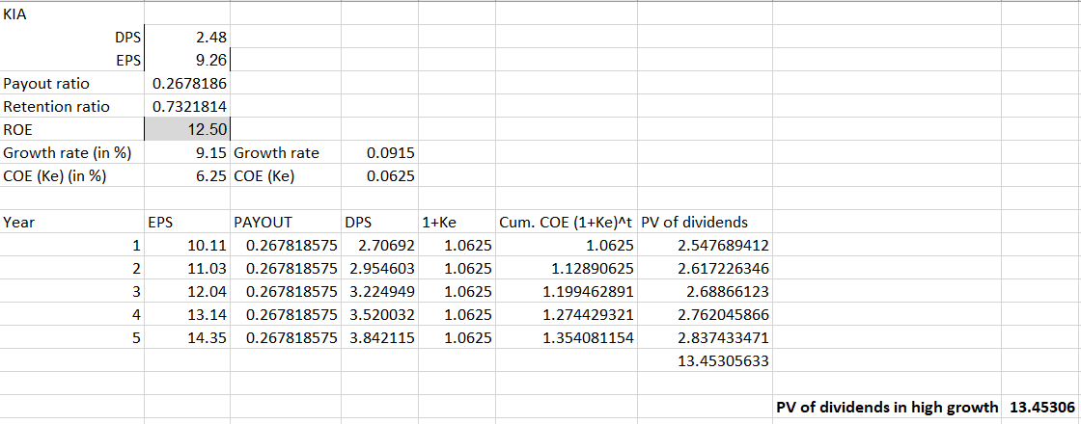


2 STAGE DIVIDEND DISCOUNT MODEL
High growth period of KIA:
We have calculated the present value of dividends in high growth period of first five years after the current year using the following procedure. The value obtained was 13.45306 dollars per share.
Stable growth period of KIA:
Now the growth rate is stable and we calculate the terminal price of the dividends using the sixth-year earnings per share. Then we calculate its present value as shown below. We obtained the present value of terminal price as 72.77379432 dollars per share. Since Kia motors is a South-Korean company, we have taken the economic growth rate of South-Korea.
Total value of Kia stock:
The total value of Kia stock is calculated by taking the sum of present values of dividends in high growth period and terminal price of stable growth. The total value obtained is 86.22685 dollars per share.
High growth period of NISSAN:
We have calculated the present value of dividends in high growth period of first five years after the current year using the following procedure. The value obtained was 0.166703 dollars per share.

Slide 21
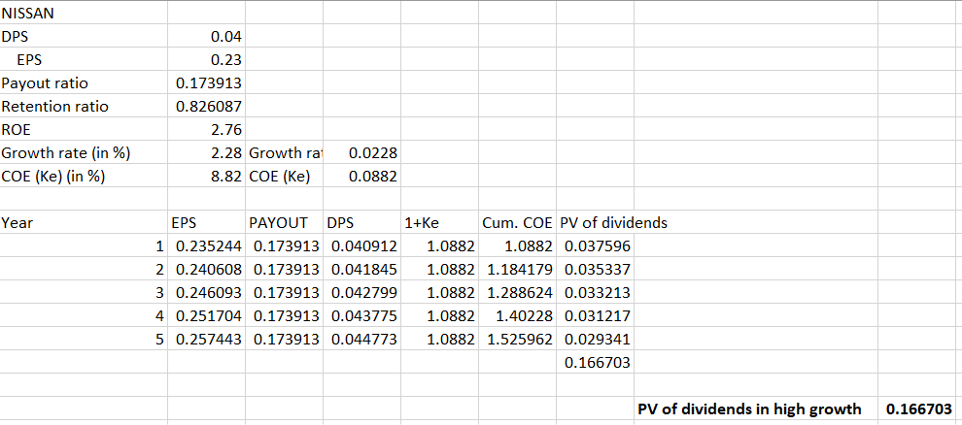
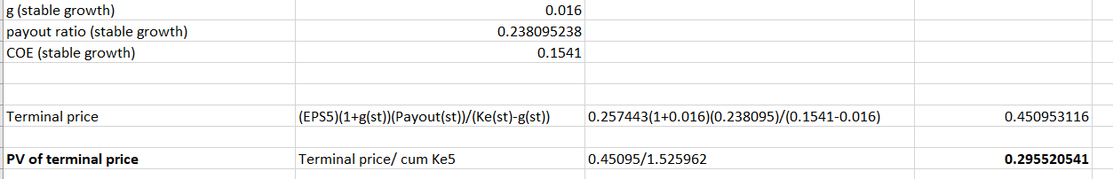

Stable growth period of NISSAN:
Now the growth rate is stable and we calculate the terminal price of the dividends using the sixth-year earnings per share. Then we calculate its present value as shown below. We obtained the present value of terminal price as 0.295520541 dollars per share. Since Nissan is a Japanese company, we have taken the economic growth rate of Japan.
Total value of Nissan stock:
The total value of Nissan stock is calculated by taking the sum of present values of dividends in high growth period and terminal price of stable growth. The total value obtained is 0.462223384 dollars per share.
High growth period of YAMAHA:
We have calculated the present value of dividends in high growth period of first five years after the current year using the following procedure. The value obtained was 4.932698 dollars per share.

Slide 22
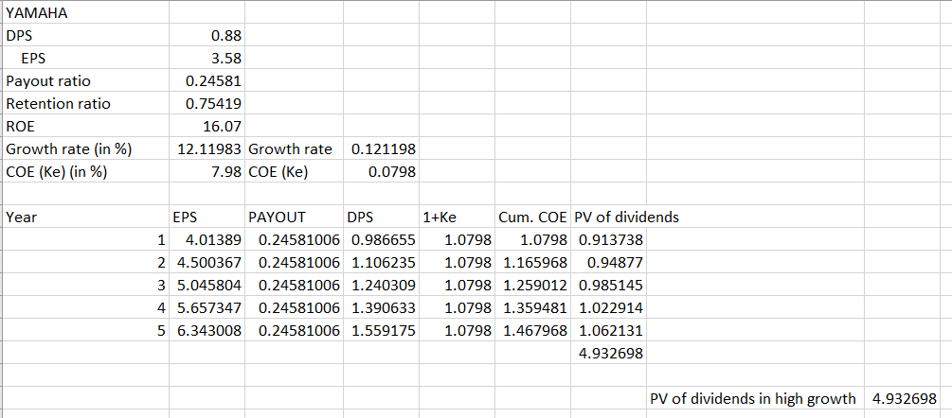
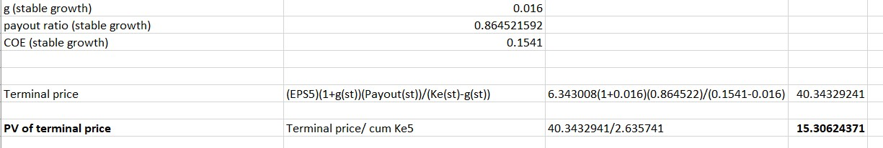

Stable growth period of YAMAHA:
Now the growth rate is stable and we calculate the terminal price of the dividends using the sixth-year earnings per share. Then we calculate its present value as shown below. We obtained the present value of terminal price as 15.30624371 dollars per share. Since Yamaha is a Japanese company, we have taken the economic growth rate of Japan.
Total value of YAMAHA:
The total value of Yamaha stock is calculated by taking the sum of present values of dividends in high growth period, transition period and terminal price of stable growth. The total value obtained is 20.23894199 dollars per share.
3 STAGE DIVIDEND DISCOUNT MODEL
High growth period of KIA:
We have calculated the present value of dividends in high growth period of first five years after the current year using the following procedure. The value obtained was 13.45306 dollars per share.

Slide 23
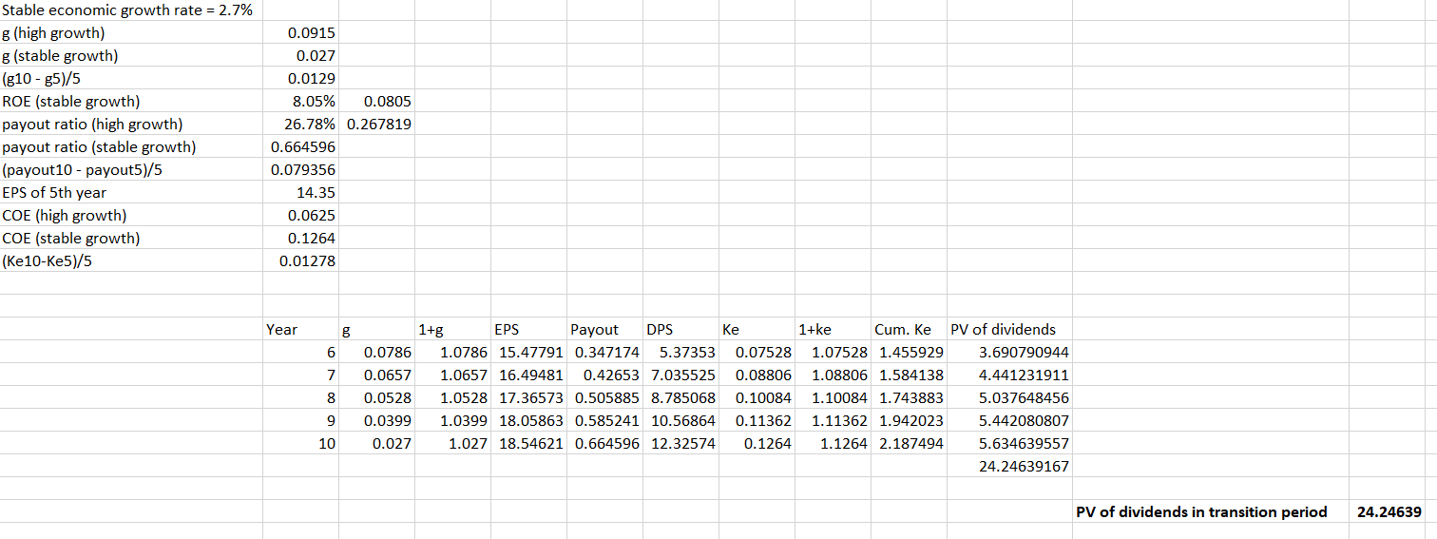
Transition period of KIA:
In the transition period i.e., from sixth year to tenth year from the current year the growth rate decreases linearly as shown below. The pay-out ratio and cost of equity also change linearly as shown below. We obtained the present value of dividends in transition period of Kia motors as 24.24639 dollars per share.
Stable growth period of KIA:
Now the growth rate is stable and we calculate the terminal price of the dividends using the eleventh-year earnings per share. Then we calculate its present value as shown below. We obtained the present value of terminal price as 72.77379432 dollars per share. Since Kia motors is a South-Korean company, we have taken the economic growth rate of South-Korea.
Total value of Kia stock:
The total value of Kia stock is calculated by taking the sum of present values of dividends in high growth period, transition period and terminal price of stable growth. The total value obtained is 110.4732423 dollars per share.

Slide 24

High growth period of NISSAN:
We have calculated the present value of dividends in high growth period of first five years after the current year using the following procedure. The value obtained was 0.166703 dollars per share.
Transition period of NISSAN:
In the transition period i.e., from sixth year to tenth year from the current year the growth rate decreases linearly as shown below. The pay-out ratio and cost of equity also change linearly as shown below. We obtained the present value of dividends in transition period of Nissan as 0.13569 dollars per share.

Slide 25
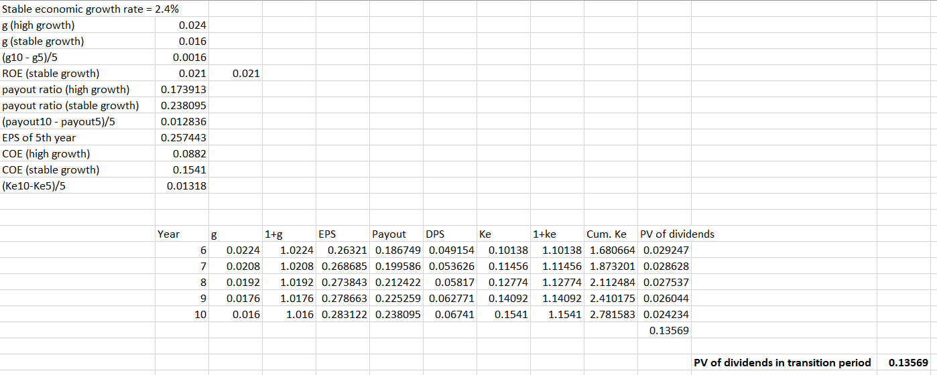
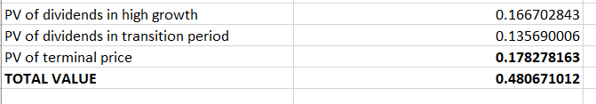
Stable growth period of NISSAN:
Now the growth rate is stable and we calculate the terminal price of the dividends using the eleventh-year earnings per share. Then we calculate its present value as shown below. We obtained the present value of terminal price as 0.178278163 dollars per share. Since Nissan is a Japanese company, we have taken the economic growth rate of Japan.
Total value of Nissan stock:
The total value of Nissan stock is calculated by taking the sum of present values of dividends in high growth period, transition period and terminal price of stable growth. The total value obtained is 0.480671012 dollars per share.
High growth period of YAMAHA:
We have calculated the present value of dividends in high growth period of first five years after the current year using the following procedure. The value obtained was 4.932698 dollars per share.

Slide 26
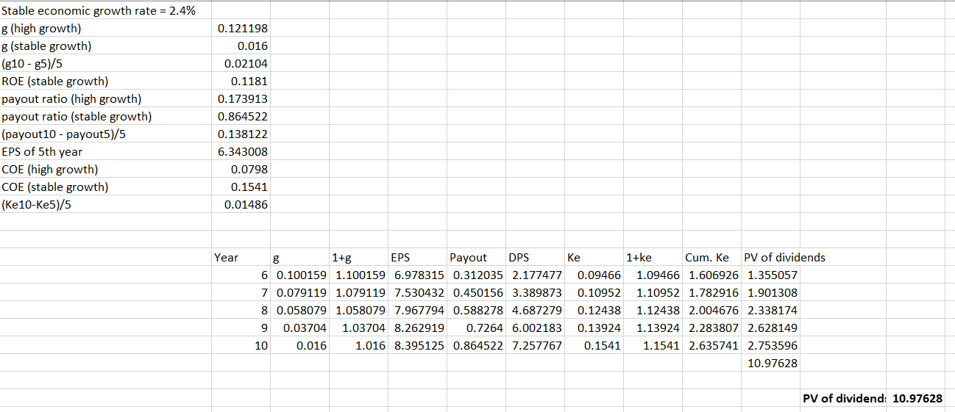
Transition period of YAMAHA:
In the transition period i.e., from sixth year to tenth year from the current year the growth rate decreases linearly as shown below. The pay-out ratio and cost of equity also change linearly as shown below. We obtained the present value of dividends in transition period of Yamaha as 10.97628 dollars per share.
Stable growth period of YAMAHA:
Now the growth rate is stable and we calculate the terminal price of the dividends using the eleventh-year earnings per share. Then we calculate its present value as shown below. We obtained the present

Slide 27
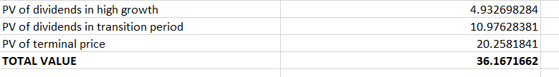
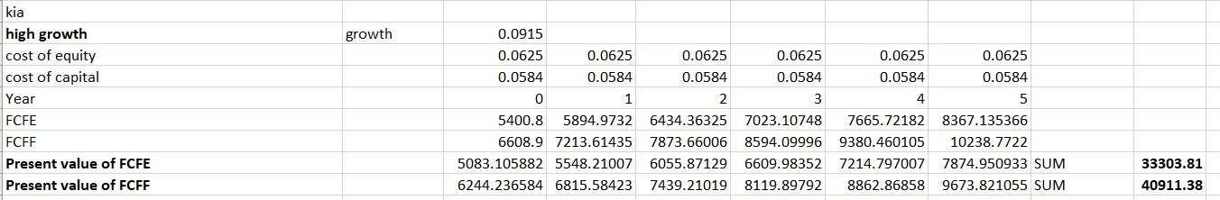
value of terminal price as 20.2581841 dollars per share. Since Yamaha is a Japanese company, we have taken the economic growth rate of Japan.
Total value of YAMAHA:
The total value of Yamaha stock is calculated by taking the sum of present values of dividends in high growth period, transition period and terminal price of stable growth. The total value obtained is 36.1671662 dollars per share.
VALUATION USING FCFE AND FCFF
High growth period of Kia:
The company experiences high growth period for the first five years after the current year. By taking the FCFE values of current year and using the high growth rate we have calculated the FCFE and FCFF values for the five years of high growth period as shown below. We then calculate the present values of FCFE AND FCFF using cost of equity and cost of capital values respectively. We obtained the present value of FCFE as 33303.81 dollars and the present value of FCFF as 40911.38 dollars for the high growth period.
Transition period of Kia:

Slide 28
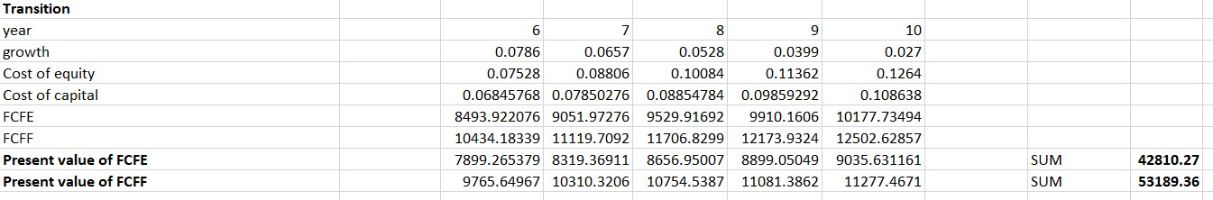
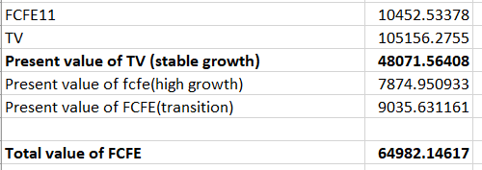
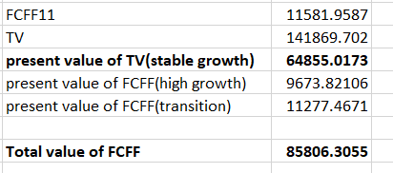
From sixth year to tenth year there is a transition period where the growth rate decreases linearly as shown below. Using these growth values, we calculate the FCFE and FCFF values till tenth year. Similarly, the cost of equity and cost of capital also change linearly. Using these values, we calculate the present values of FCFE and FCFE respectively as shown below. We obtained the present value of FCFE as 42810.27 dollars and the present value of FCFF as 53189.36 dollars for the transition period.
Stable growth period of Kia (FCFE):
From the eleventh year there is stable growth period. Since Kia is a South-Korean company we have taken the economic growth rate of South-Korea. We then calculate the terminal value of FCFE in stable growth using the FCFE of eleventh-year along with cost of equity and growth rate of stable growth period. Using this value, we calculate the present value of terminal value with the cumulative value of cost of equity of tenth year. We obtained the Present value of terminal value of FCFE as 48071.56408 dollars.
Total value of FCFE: 64982.14617 dollars is obtained by taking the sum of present values of FCFE in high growth period, transition period and terminal value in stable growth period.
Stable growth period of Kia (FCFF):
From the eleventh year there is stable growth period. Since Kia is a South-Korean company we have taken the economic growth rate of South-Korea. We then calculate the terminal value of FCFF in stable growth using the FCFF of eleventh-year along with cost of capital and growth rate of stable growth period. Using this value, we calculate the present value of terminal value with the cumulative value of cost of capital of tenth year. We obtained the Present value of terminal value of FCFF as 64855.0173 dollars.
Total value of FCFF: 85806.3055 dollars is obtained by taking the sum of present values of FCFF in high growth period, transition period and terminal value in stable growth period.

Slide 29
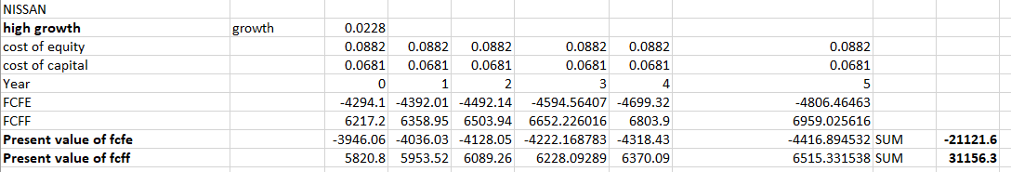
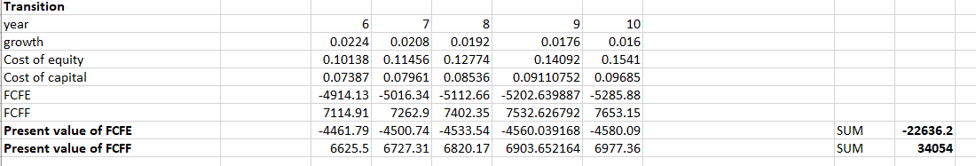
High growth period of Nissan:
The company experiences high growth period for the first five years after the current year. By taking the FCFE values of current year and using the high growth rate we have calculated the FCFE and FCFF values for the five years of high growth period as shown below. We then calculate the present values of FCFE AND FCFF using cost of equity and cost of capital values respectively. We obtained the present value of FCFE as -21121.6 dollars and the present value of FCFF as 31156.3 dollars for the high growth period.
Transition period of Nissan:
From sixth year to tenth year there is a transition period where the growth rate decreases linearly as shown below. Using these growth values, we calculate the FCFE and FCFF values till tenth year. Similarly, the cost of equity and cost of capital also change linearly. Using these values, we calculate the present values of FCFE and FCFE respectively as shown below. We obtained the present value of FCFE as -22636.2 dollars and the present value of FCFF as 34054 dollars for the transition period.
Stable growth period of Nissan: (FCFE)
From the eleventh year there is stable growth period. Since Nissan is a Japanese company we have taken the economic growth rate of Japan. We then calculate the terminal value of FCFE in stable growth using the FCFE of eleventh-year along with cost of equity and growth rate of stable growth period. Using this value, we calculate the present value of terminal value with the cumulative value of cost of equity of tenth year. We obtained the Present value of terminal value of FCFE as -13981.00655 dollars.

Slide 30
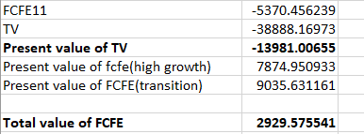
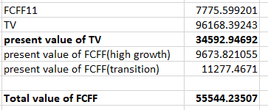
Total value of FCFE: 2929.575541 dollars is obtained by taking the sum of present values of FCFE in high growth period, transition period and terminal value in stable growth period.
Stable growth period of Nissan (FCFF):
From the eleventh year there is stable growth period. Since Nissan is a Japanese company, we have taken the economic growth rate of Japan. We then calculate the terminal value of FCFF in stable growth using the FCFF of eleventh-year along with cost of capital and growth rate of stable growth period. Using this value, we calculate the present value of terminal value with the cumulative value of cost of capital of tenth year. We obtained the Present value of terminal value of FCFE as 34592.94692 dollars.
Total value of FCFF: 55544.23507 dollars is obtained by taking the sum of present values of FCFF in high growth period, transition period and terminal value in stable growth period.

Slide 31
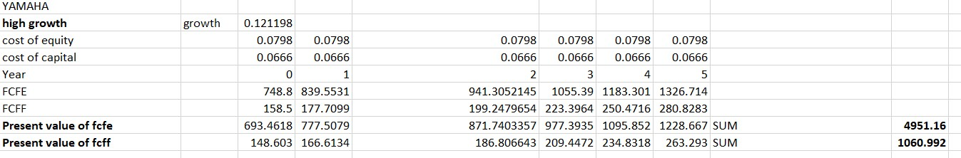
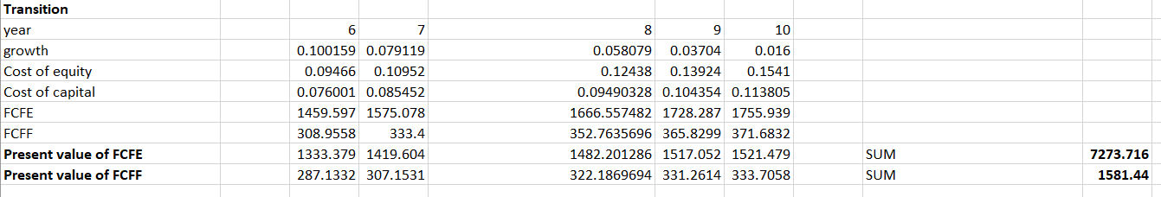
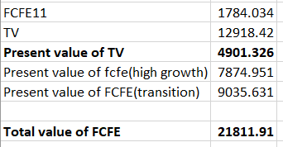
High growth period of Yamaha:
The company experiences high growth period for the first five years after the current year. By taking the FCFE values of current year and using the high growth rate we have calculated the FCFE and FCFF values for the five years of high growth period as shown below. We then calculate the present values of FCFE AND FCFF using cost of equity and cost of capital values respectively. We obtained the present value of FCFE as 4951.16 dollars and the present value of FCFF as 1060.992 dollars for the high growth period.
Transition period of Yamaha:
From sixth year to tenth year there is a transition period where the growth rate decreases linearly as shown below. Using these growth values, we calculate the FCFE and FCFF values till tenth year. Similarly, the cost of equity and cost of capital also change linearly. Using these values, we calculate the present values of FCFE and FCFE respectively as shown below. We obtained the present value of FCFE as 7273.716 dollars and the present value of FCFF as 1581.44 dollars for the transition period.
Stable growth period of Yamaha: (FCFE)
From the eleventh year there is stable growth period. Since Yamaha is a Japanese company, we have taken the economic growth rate of Japan. We then calculate the terminal value of FCFE in stable growth using the FCFE of eleventh-year along with cost of equity and growth rate of stable growth period. Using this value, we calculate the present value of terminal value with the cumulative value of cost of equity of tenth year. We obtained the Present value of terminal value of FCFE as 4901.326 dollars.
Total value of FCFE: 21811.91 dollars is obtained by taking the sum of present values of FCFE in high growth period, transition period and terminal value in stable growth period.
Stable growth period of Yamaha (FCFF):
From the eleventh year there is stable growth period. Since Yamaha is a Japanese company, we have taken the economic growth rate of Japan. We then calculate the terminal value of FCFF in stable growth using the FCFF of eleventh-year along with cost of capital and growth rate of stable growth period. Using this value, we calculate the present value of terminal value with the cumulative value of cost of capital of tenth year. We obtained the Present value of terminal value of FCFF as 1765.057 dollars.

Slide 32
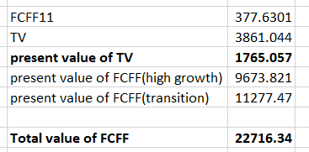
Total value of FCFF: 22716.34 dollars is obtained by taking the sum of present values of FCFF in high growth period, transition period and terminal value in stable growth period.

